Slide 1


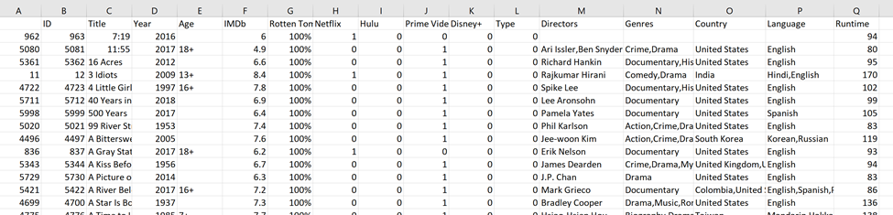
Business Scenario:
We operate a consulting firm that facilitates through two vertical channels:
Distributor Channel: (Production Studios)
Recommend which streaming service platform a movie is most likely to be picked up by
End User Channel: (Viewers)
Recommend the streaming service platform that is best suited to the end user
Basic Info
Ratings
Platform
Comma Delimited Info
Basic Info

Slide 2
Step 1: Traditional Route
Unbalanced & Balanced
Full Tree
Post Prune, Bagged, Boosted
Logit
NaiveBayes
OUR APPROACH TO THE
DISTIBUTOR CHANNEL
RECOMMENDATION
Step 2: Created Ensembles
Unbalanced & Balanced
Simple Version
Decision Tree, Bagged, Boosted
Logit
NaiveBayes
Step 3: Create CM Matrix
The Good
The Bad
The Ugly

Slide 3
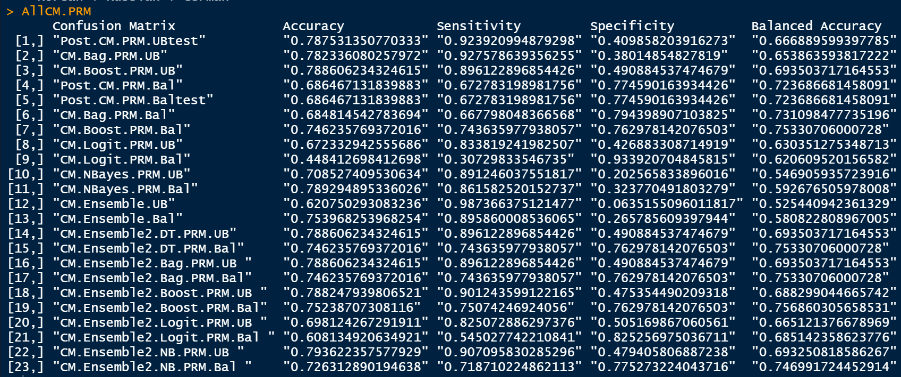

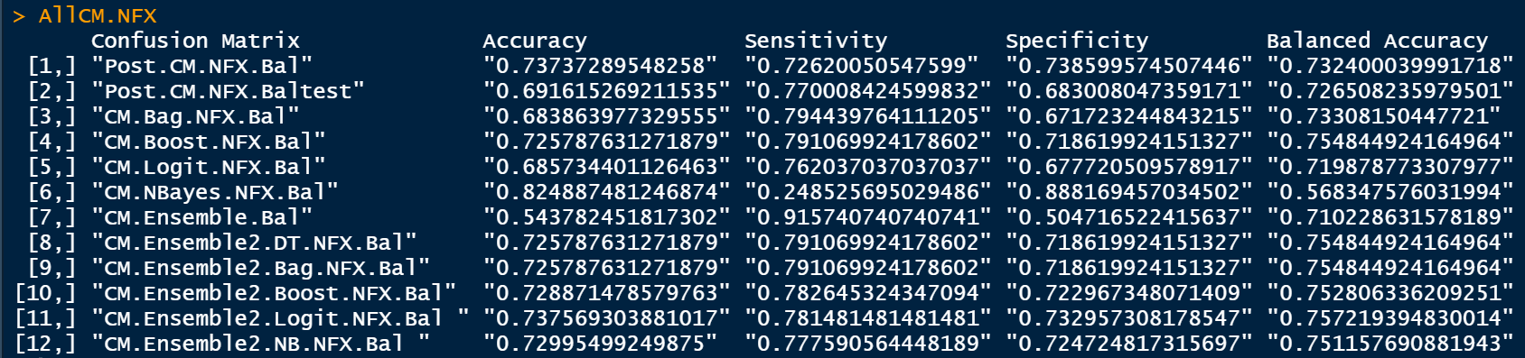

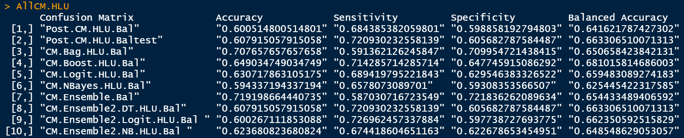

Slide 4
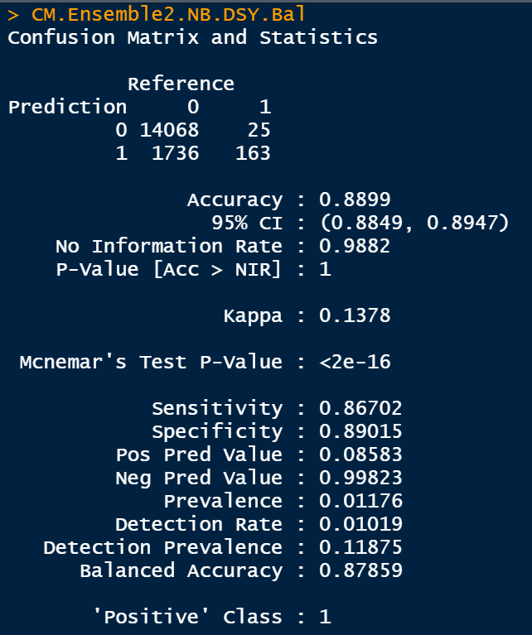
MAYBE IT IS
NOT SO GOOD AFTERALL
Great Prediction for a “NO” recommendation.
But, over 90% of the time, a “Yes” recommendation would prove to be meaningless and cost the Production Studio Time and Money

Slide 5
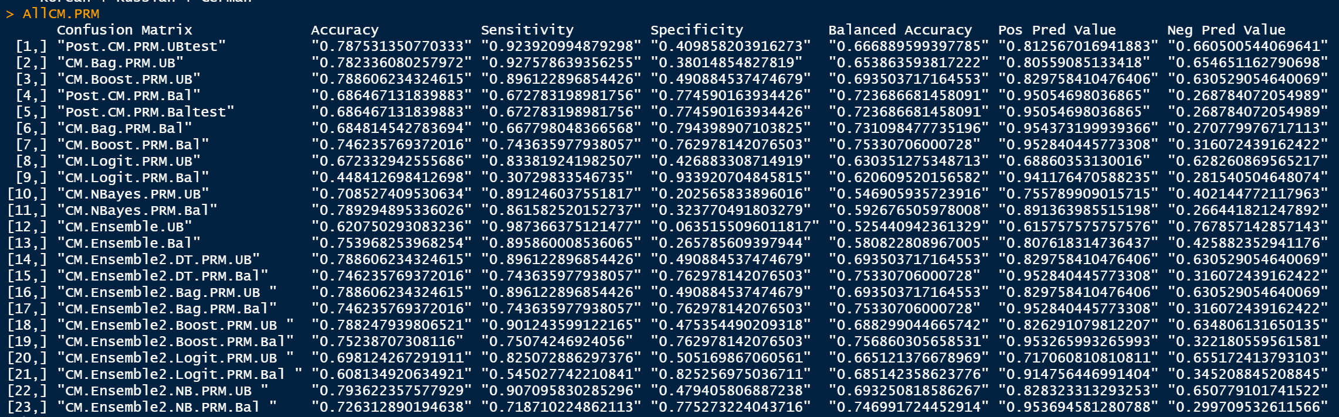


REVALUATING OUR PRIME PREDICTIONS

Slide 6
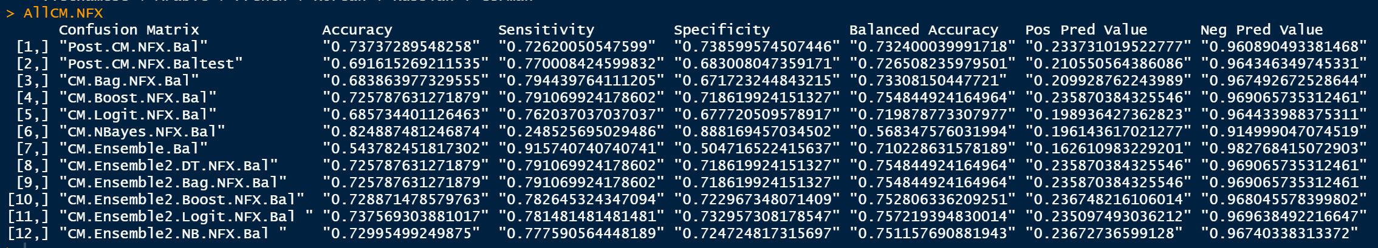
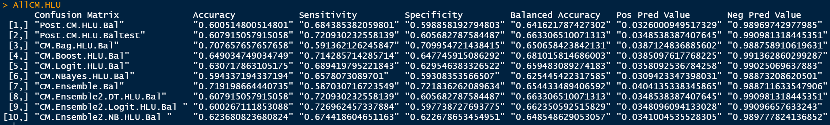
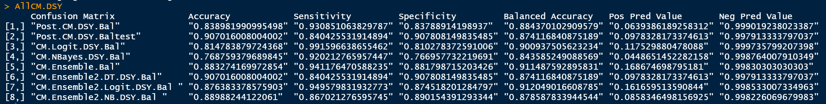


Slide 7
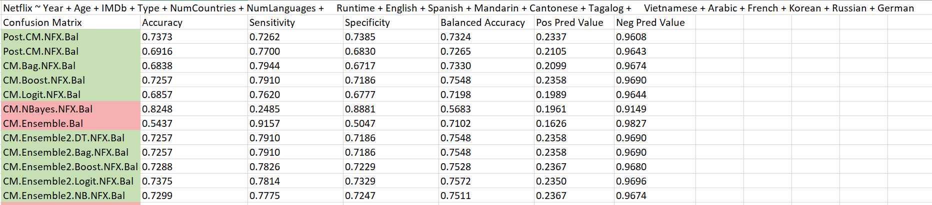
Things We tried:
MinSplit
CP Value
Test Variables
What We Found:
Didn’t make too much of a difference

Slide 8
Key Take Away
Great at Predicting
“YES”
Great at Predicting
“NO”
No Confidence in saying
“YES”

Slide 9
An Epiphany
Our Positive Predicted Value for Amazon Prime was so strong and covered so much of the data, we should be able to leverage an Amazon Prime Prediction to reduce the alpha of Netflix, Hulu, and Disney+ predictions
What if we used a waterfall approach and built predictions based on previous predictions
Why this might Work:

Slide 10
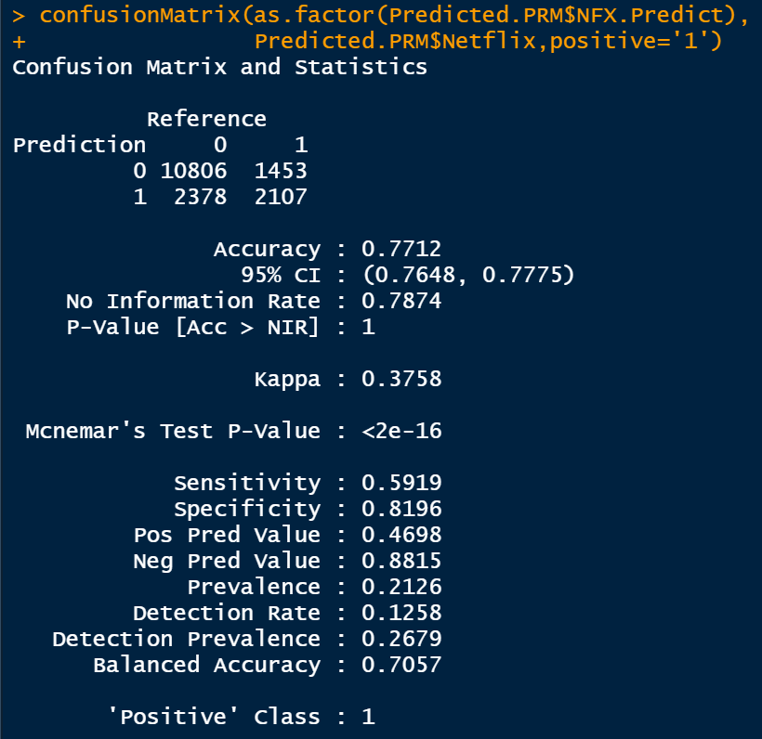
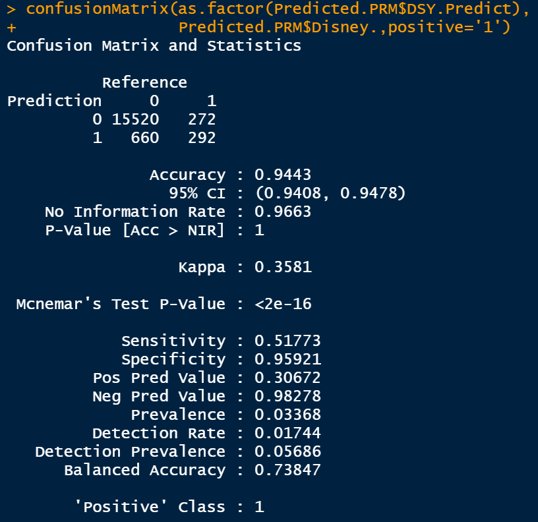
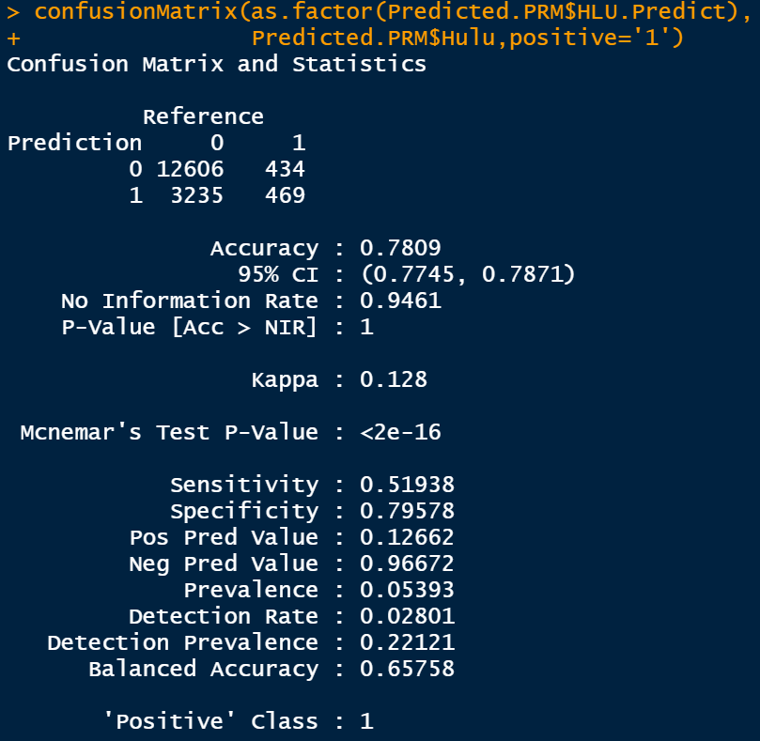
Applying Amazon Prime Prediction
To The Others (using Logit)
Netflix Pos Pred Value Near 50%
Disney+ Pos Pred Value near 30%
Hulu Still Falls in the Ugly Category

Slide 11
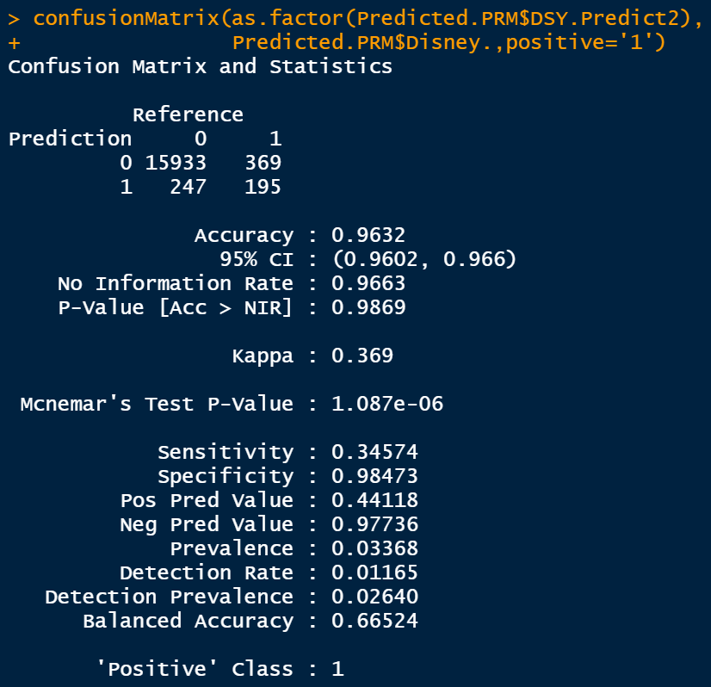
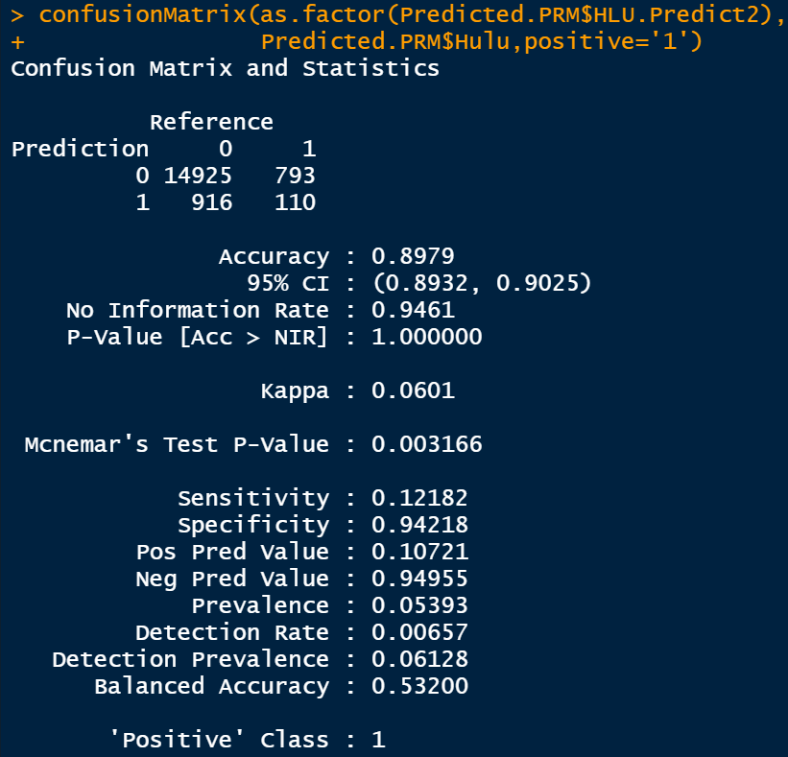

Applying Amazon Prime & Netflix
Prediction To The Others
Applying All
for Hulu
Disney+ Pos Pred Value near 45%
Hulu Drops Slightly
Hulu Still Falls in the Ugly Category

Slide 12
New Take Away
Great at Predicting
“YES”
Great at Predicting
“NO”
More Confidence in saying
“YES”
Still No Confidence in saying
“YES”

Slide 13

Final Predictive Analysis
Could We Do Even Better?

Slide 14
Business Vertical 2: End User Recommendation
Helping consumers select platforms based on:
Age Group
Stratification by Platform
Focused by Content
Quality
Genres
Number of movies by genres
Proportion of movies per streaming service
Distribution of movies by IMDb scores
Run-Time and IMDb
Focused by Ratings
Language
English
Non-English
Notes:
Thank you rob for that great information, Now, we’ll discuss our second business vertical where we recommend streaming platforms to movie viewers based on the key variables you see here.

Slide 15
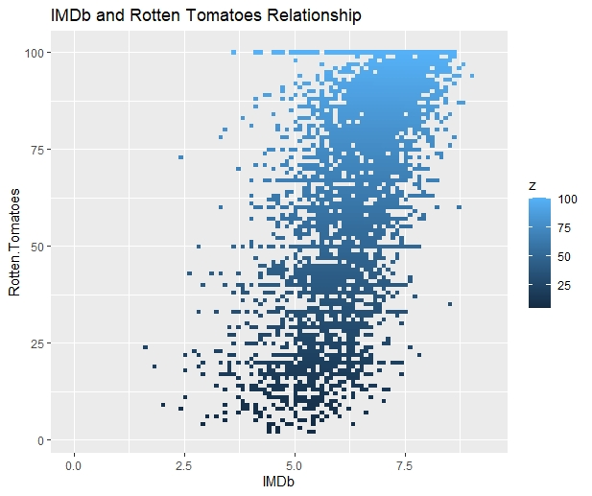
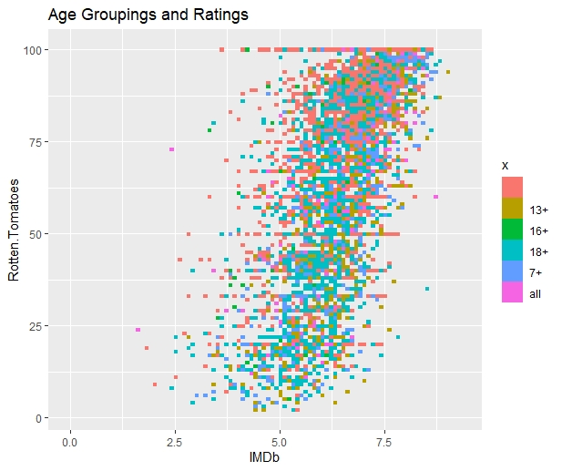
Age Group – Overall look
Notes:
Beginning with Age Bracket, we first wanted to find comparison points for the age variable to show value, and when combining the IMDb and Rotten Tomatoes scores we saw a similar grading response to all content. When you position age onto the graph, we see that all the content available is spread evenly across all age groups, meaning youll get good content no matter what age grouping.

Slide 16
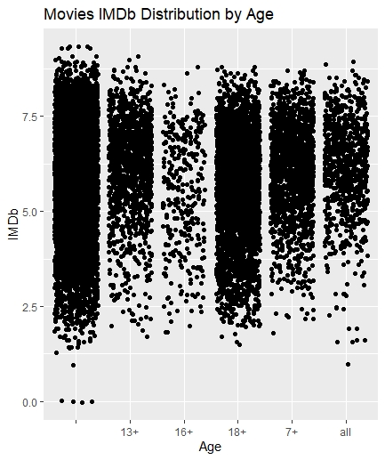
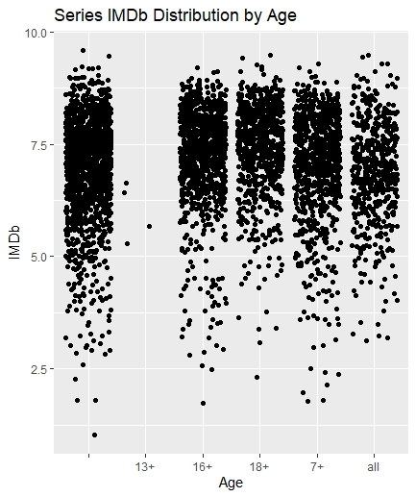
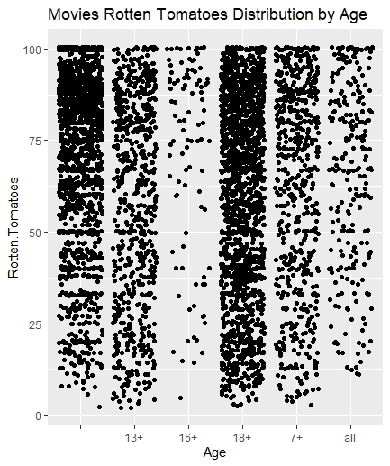
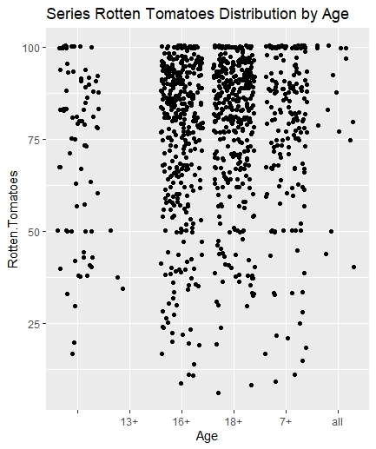
Age Data – Ratings on Movies vs Series
Better at rating content overall
Better at rating 16+ content
Notes:
Here we break down furthur into the ratings by age group by showing how much of the data is UNRATED, and which category dominates the space – 18+ content.
We also see here that IMDb is a much more well rounded rating system, as it covers series and movies alike, where as rotten tomatoes shows sparce participation in series.

Slide 17
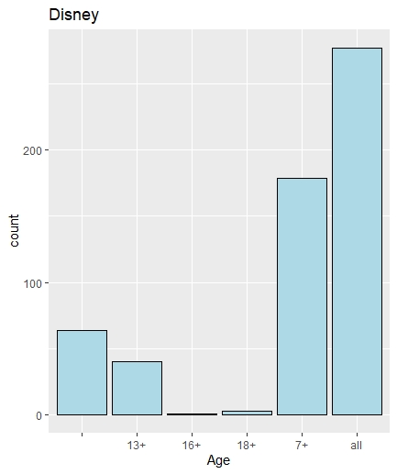
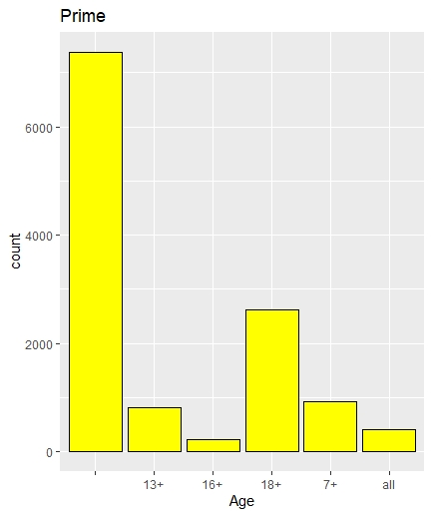
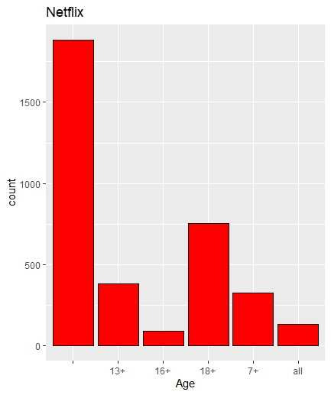
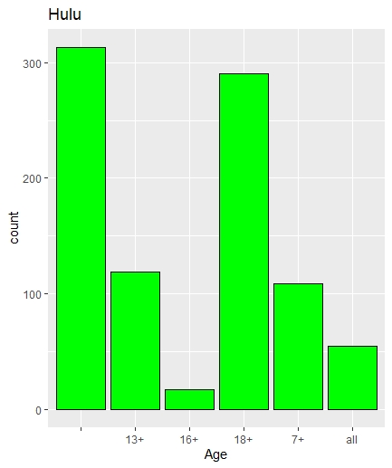
Age Group, Child, Adolescent, Adult, & Family
Medium Content
High Content
High Content
Medium Content
More Content Generates a similar offerings portfolio overall
More Child Friendly
More Adolescent & Adult Friendly
Notes:
Looking at the grouping of content, we see a clearer picture forming of where each service lies.
Disney has much more rated content, and is heavily focused on the family content and Hulu is much more aware of its adolescent to adult content.
Because Netflix and prime have such large portfolios, their content has normalized somewhat to have content for everyone, but they still lean in separate directions.

Slide 18
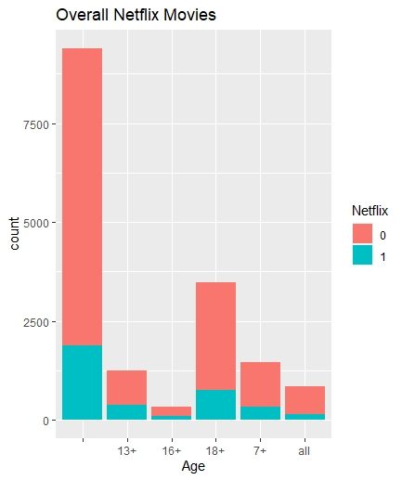
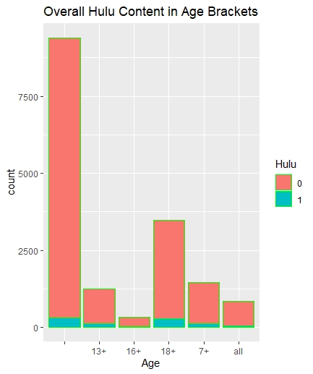
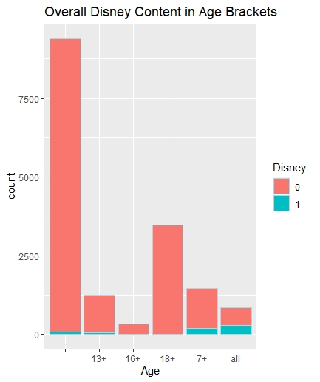
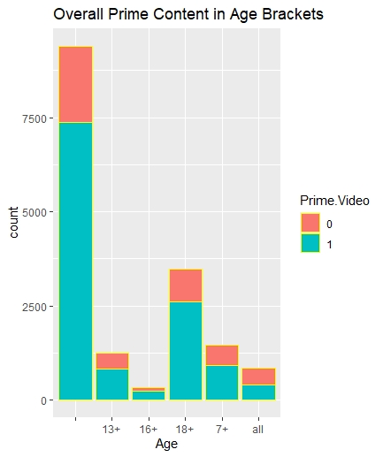
Age Group - Movie content
Options on Adolescent Side
Options on Family Side
Notes:
Further breaking down content for the adolescent and family friendly sides, we see prime dominating the family movie space and Netflix dominating the 13+ cinemas, with Disney and Hulu focusing on series within their age brackets.

Slide 19
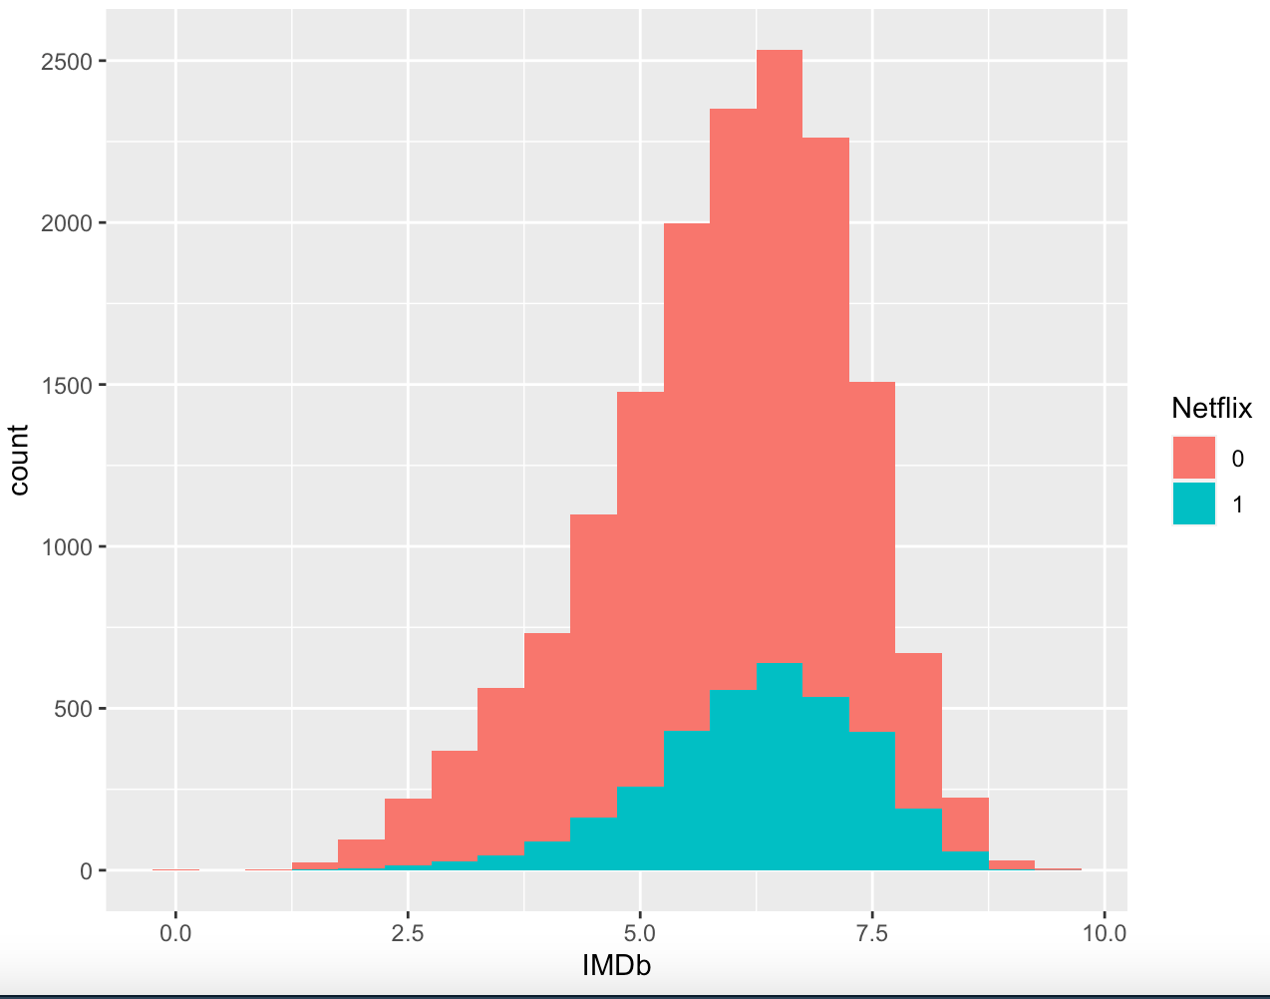
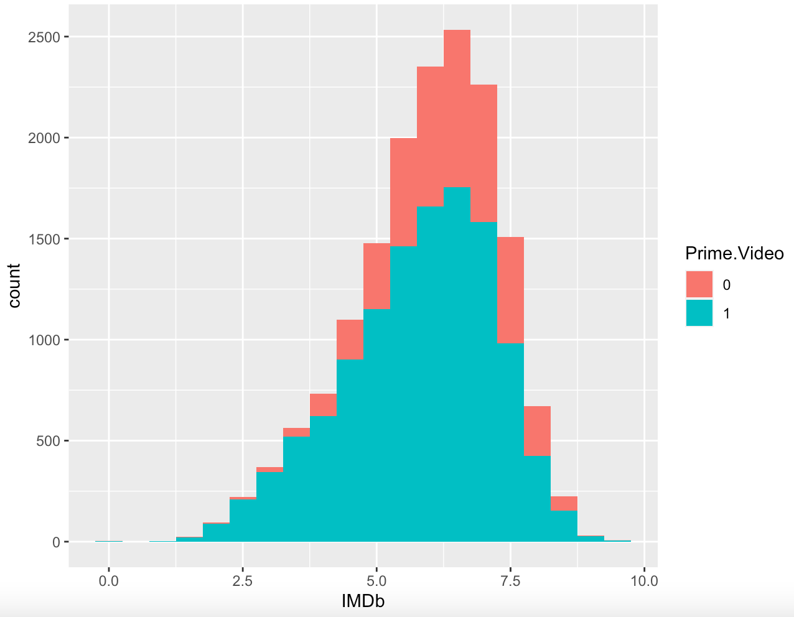
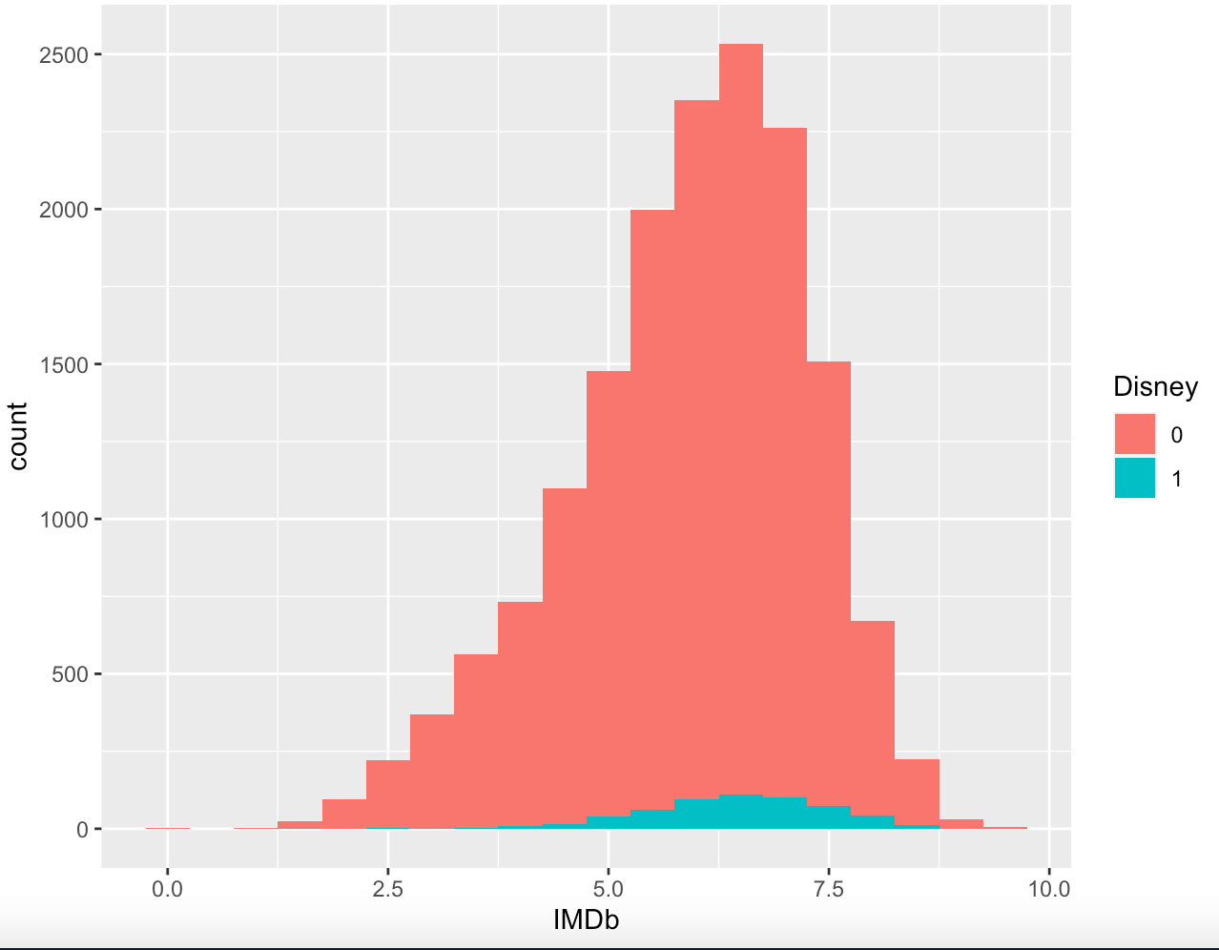
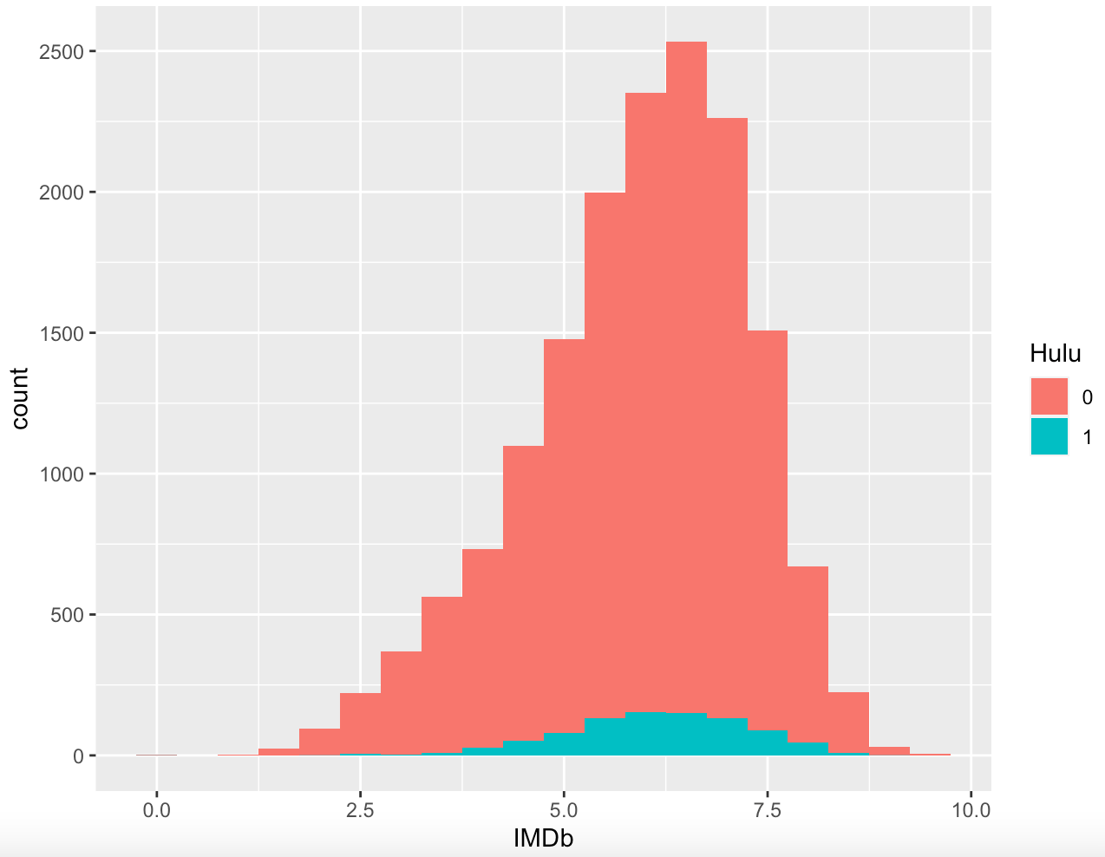
Distribution of IMDb Scores by Platform
Netflix IMDb Distribution
Prime Video IMDb Distribution
Hulu IMDb Distribution
Disney IMDb Distribution
Notes:
Here we can see the distribution of movies by IMDb rating in each platform. The coral colored portion is the distribution of all IMDb ratings in our data set, and the blue portion is the distribution of IMDb ratings for movies on each of the platforms. Although the platforms have vastly different numbers of movies with ratings, all platforms have a similar distribution pattern along IMDb scores. According to our analysis, IMDb ratings are NOT a great decision tool for selecting a platform for a consumer.

Slide 20
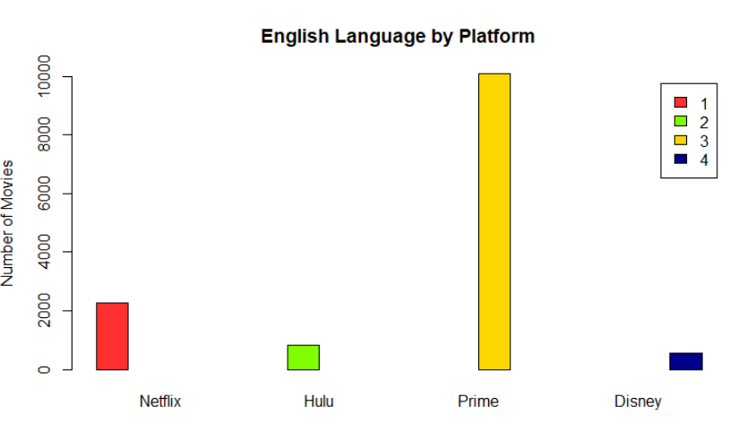
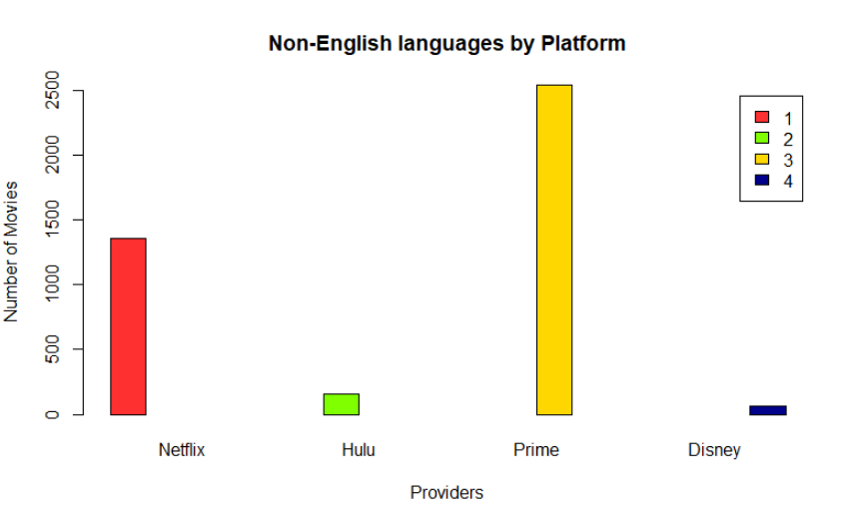
Language
Notes:
Here we can see the language sections, most notably Prime video and Netflix have the highest options both for English and Non-English languages. In addition to this, Disney has the absolute worst options for non-English speakers with only 64 movies total.

Slide 21
Genres
Prime Video has more movies than all platforms in all genres
Followed by Netflix in almost all genres
Notes:
Displayed here, you can see the number of movies each platform has per genre. It is clear that Prime Video has more movies in every genre than all of the other platforms with a notable number of movies in the Drama category. Netflix has the second highest number of movies in most of the genres with Disney overtaking Netflix in only one genre: Family movies. From this graphic, we would recommend that consumers looking for a large number of movie options consider Prime Video.

Slide 22
Genres
Proportions of movies genres are very similar in Netflix, Prime, and Hulu platforms.
Disney has higher proportions of
Musicals,
Fantasy,
Animation,
Family, and
Adventure movies
Notes:
Here we have the proportion of genres in each platform. What is interesting here is that three platforms: Netflix, Prime, and Hulu have very similar proportions of genres available with only slight variations (Netflix has a slightly higher proportion of comedy. Prime has somewhat higher proportion of drama movies). But, Disney+ has obvious differences in genre priorities with higher proportions of musicals, fantasy, family, and adventure movies.

Slide 23
We recommend:
For customers looking for sheer volume of movies available
For customers looking for Non-English movie options
For customers who want a wide variety of movie options, but not to be overwhelmed by the volume of Prime
Overall adolescent content.
For customers seeking family-friendly movie content or who prefer musicals, adventure, and fantasy movie genres.
Family friendly series streamer.
For customer who prioritize television shows
Adolescent series focused content
Notes:
Based on our analysis:
Our recommendations for customers looking for a LARGE numbers of movie options and who may have a preference for non-English movie options, we would recommend Prime Video.
For customers looking for a wide range of movie options but do not want to be overwhelmed by huge quantities of movies, we would recommend Netflix.
For customers seeking family-friendly content or who prefer musicals, adventure, and fantasy movie genres, we would recommend Disney +.
For customers who prioritize television shows or who are looking for adolescent focused content, we would recommend Hulu plus.

Slide 24
We appreciate your time.
Thank you, any questions?

